Slide 1

Blockchain
Aiden Wesley

Slide 2

What is the blockchain?
Blockchain is a decentralized and tamper-resistant digital ledger that records transactions across a network of computers. It relies on consensus algorithms and cryptographic techniques to ensure transparency, security, and immutability of the recorded data.

Slide 3

Programming Language
I have chosen Python and visual studio code to build my blockchain program in.

Slide 4

‘Block’ Class
index: Block index in the blockchain.
previous_hash: Hash of the previous block.
timestamp: Time when the block was created.
data: Data of the block.
hash: Hash of the block.
sender: Sender's username for a transaction block.
receiver: Receiver's username for a transaction block.

Slide 5
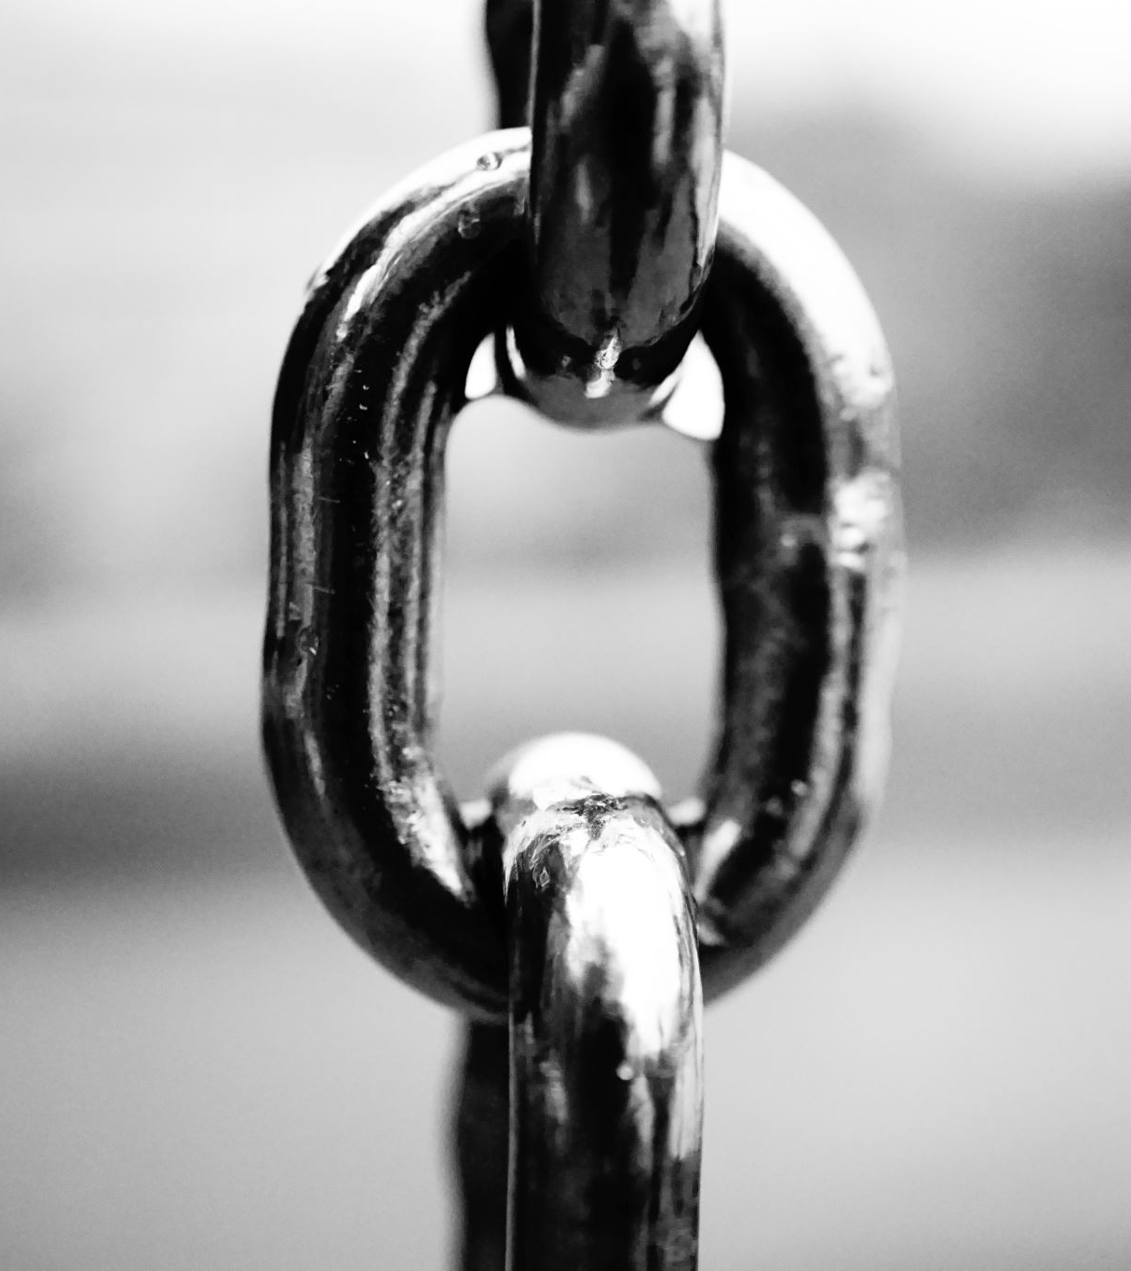
‘Blockchain’ Class
Attributes:
chain: List to store blocks in the blockchain.

Slide 6
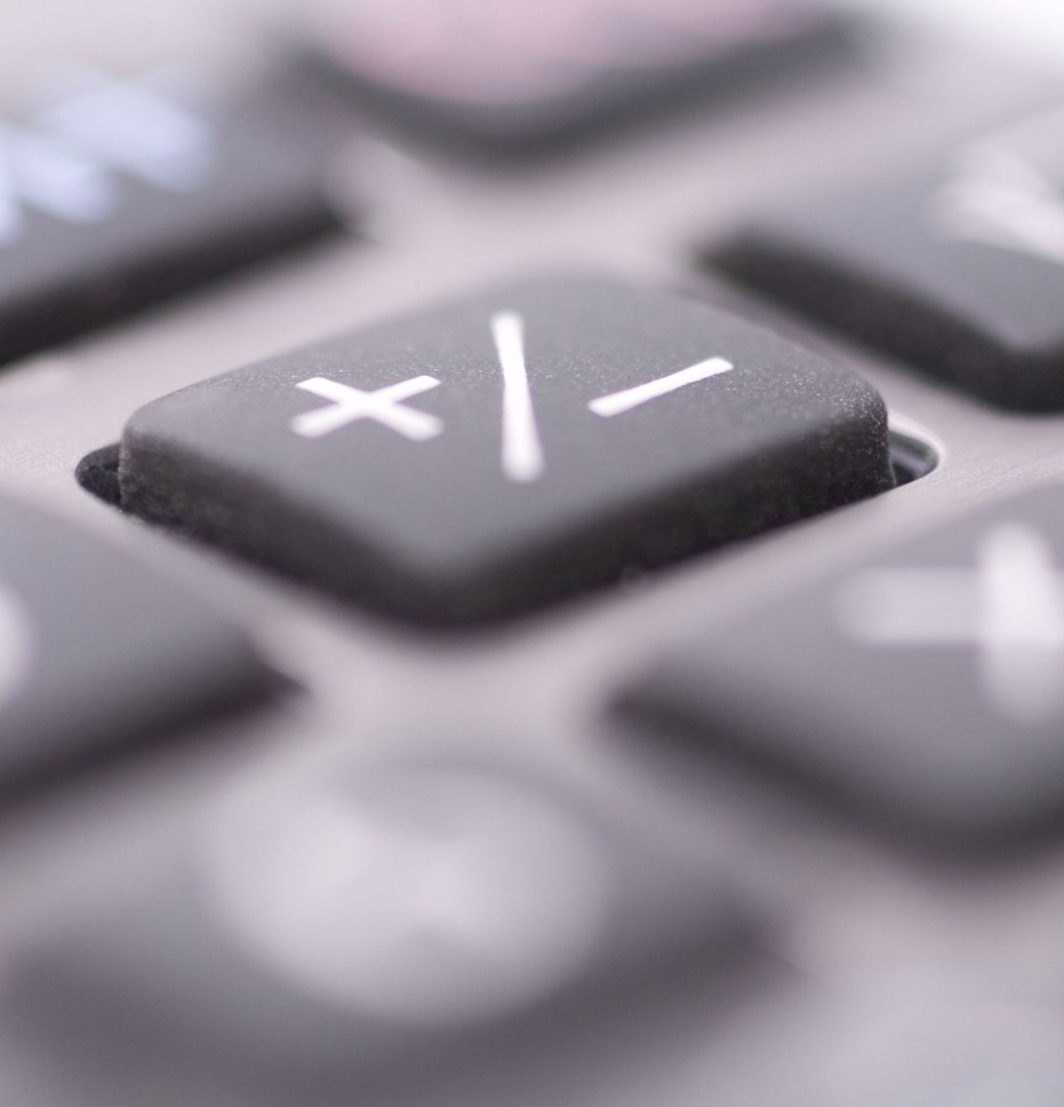
Wallet Class
Attributes:
userName: Username of the wallet.
walletID: Unique ID for the wallet.
walletBalance: Current balance of WesleyCoin in the wallet.
Methods:
__init__(userName, walletBalance=50): Initializes a new wallet with a username and optional initial balance.

Slide 7
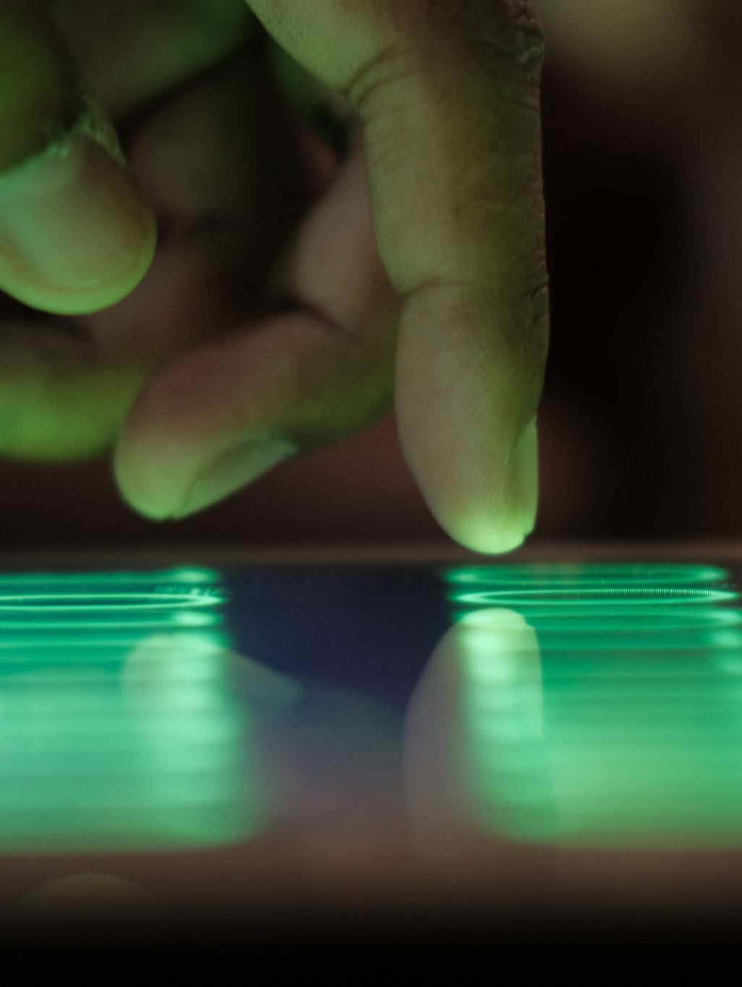
‘main’ Function
Handles user input and executes commands for user creation, transaction commitment, balance check, and blockchain display.

Slide 8
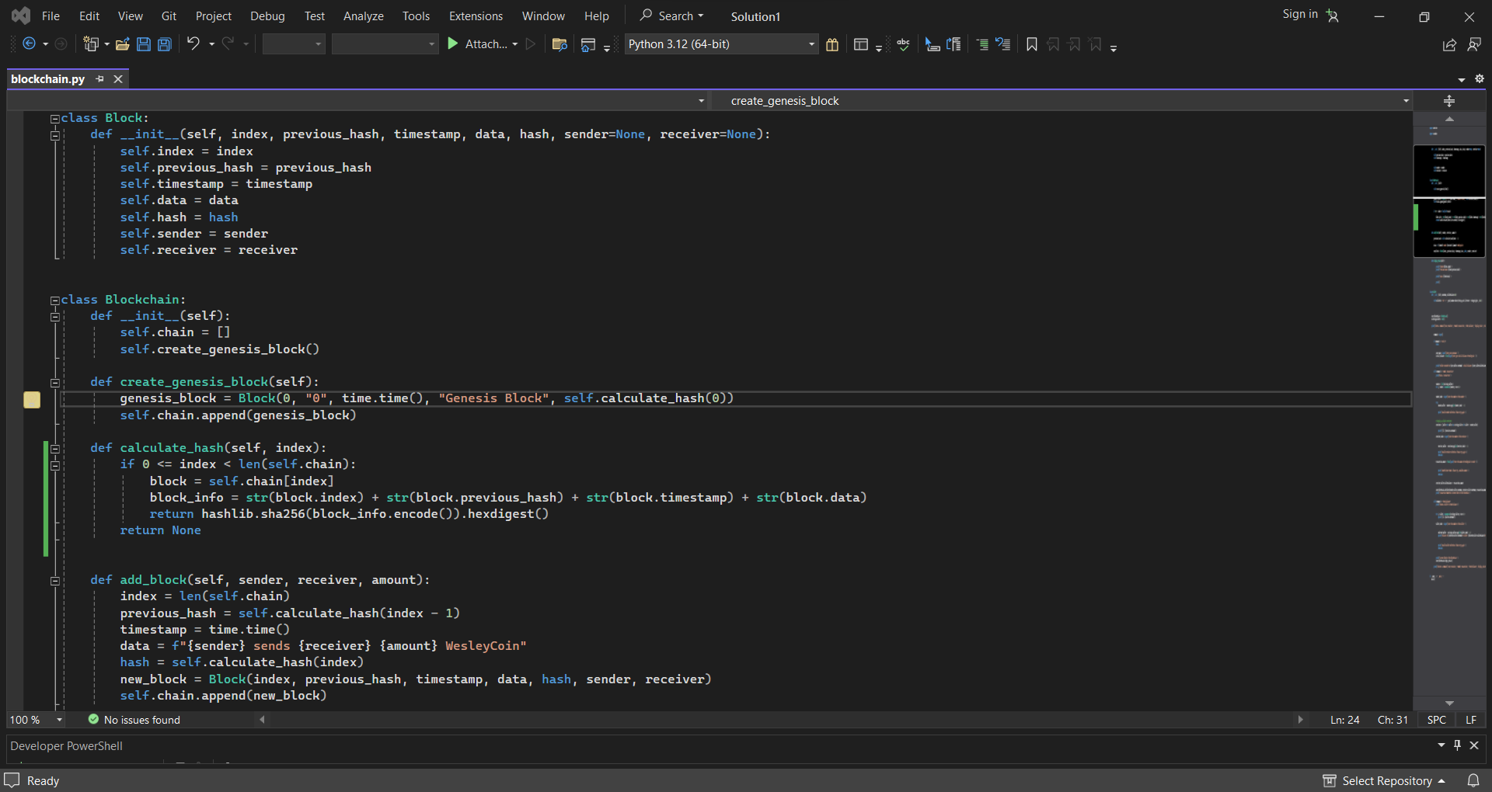
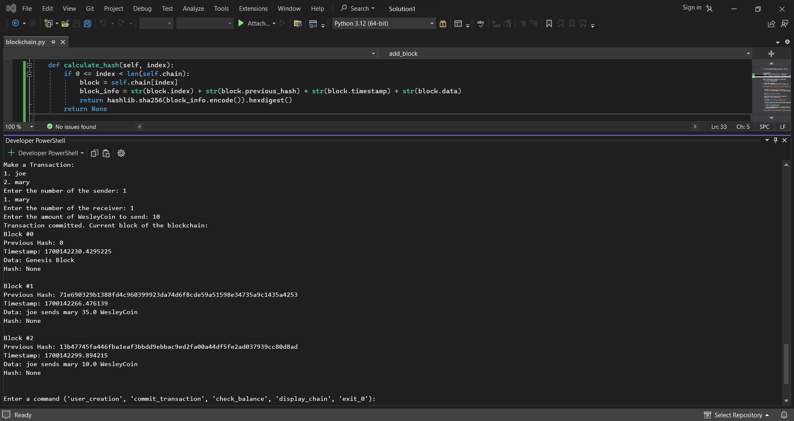
Code Overview
The code provides a simple implementation of a blockchain with blocks representing transactions between users (wallets).
Users can create wallets, commit transactions, check wallet balances, and view the current state of the blockchain.

